Slide 1

rust.cc
WebAssembly Intro
Mike
2019-07-23

Slide 2

Contents
What's WebAssembly
Current State of WebAssembly
Rust Fullstack Development
WASI
WebAssembly and Blockchain
The Role of WebAssembly in Polkadot/Substrate
Rust.cc Introduction

Slide 3

What's WebAssembly
WebAssembly (abbreviated Wasm) is a binary instruction format for a stack-based virtual machine. Wasm is designed as a portable target for compilation of high-level languages like C/C++/Rust, enabling deployment on the web for client and server applicatio (https://webassembly.org/)
Efficient and fast
Safe
Open and debuggable
Part of the open web platform

Slide 4
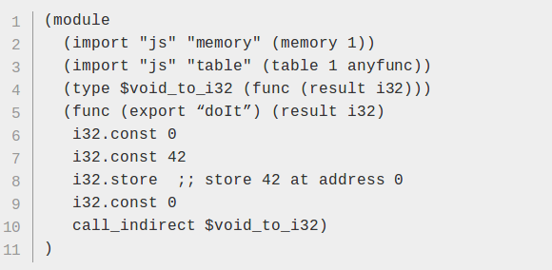
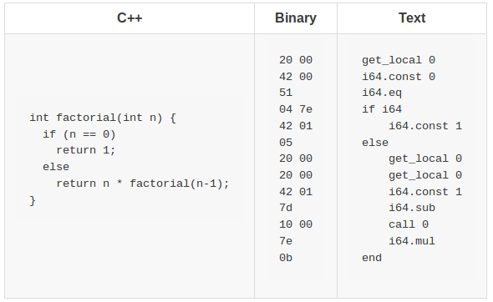
What it looks like
.wat format
No meaning for this code
Linear representation for the code in function bodies

Slide 5


Current State of WebAssembly
WebAssembly 1.0 has shipped in 4 major browser engines.
MVP 1.0
Stable and compatible binary format
Many successful stories already
Used to promote Javascript speed in Browsers.

Slide 6

Let's
Rust All The World
Rust Fullstack Development

Slide 7

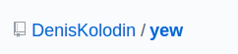
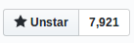
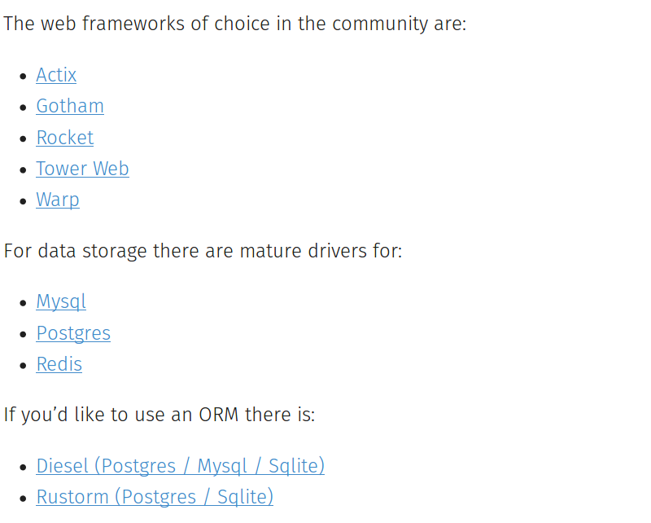
Yew(pronounced/juː/, the same way as "you") is a modern Rust framework inspired by Elm and ReactJS for creating multi-threaded frontend apps with WebAssembly.
HTML? Yes
CSS? Yes
JavaScript? No, you can't find it.
https://www.arewewebyet.org/

Slide 8
WASI
The WebAssembly System Interface
WASI is a modular system interface for WebAssembly. Interfaces to outside world! Extends beyond the Web.
It's designed to be independent of browsers, so it doesn't depend on Web APIs or JS, and isn't limited by the need to be compatible with JS. And it has integrated capability-based security, so it extends WebAssembly's characteristic sandboxing to include I/O.
wasmtime
lucet
wasmer
Java's dream, WebAssembly's next step.
Any language compiled to wasm.
Build Once, Run Anywhere. Universal Binaries powered by WebAssembly.

Slide 9

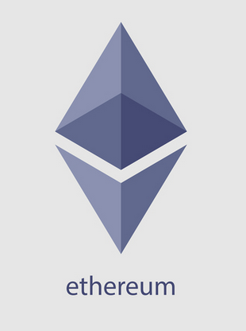


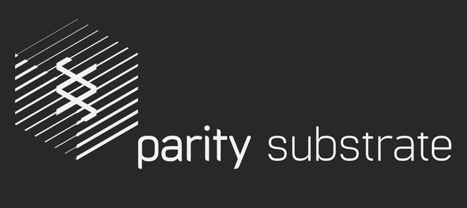
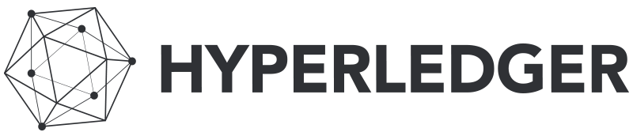

WebAssembly and Blockchain
On Research
And some other not famous projects ...

Slide 10
WebAssembly in Polkadot/Substrate
Wasm allows us to reuse existing tooling;
Wasm is easily verifiable for correctness;
Wasm allows us to effectively balance price of deployment against price of execution;
Wasm allows us to have isomorphic blockchain logic code for fork-free upgrades;
The benefits of using the formal-verification-oriented option dissolve when you try to apply it to a VM format — a Turing-incomplete language is more suitable as a frontend used by humans instead of a backend interpreted by the blockchain client;
We can’t easily use existing Wasm runtimes since our requirements are much stricter than theirs.
Secure
Deterministic
Generic
Efficient

Slide 11
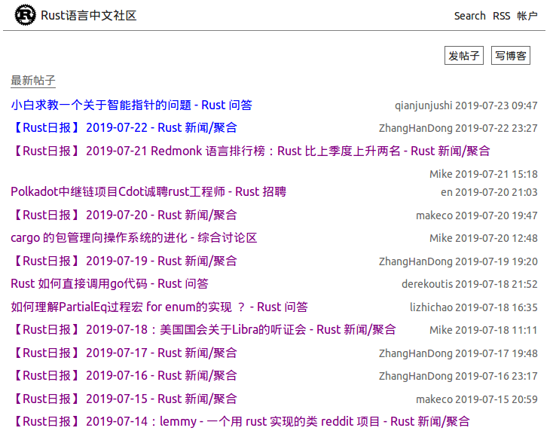
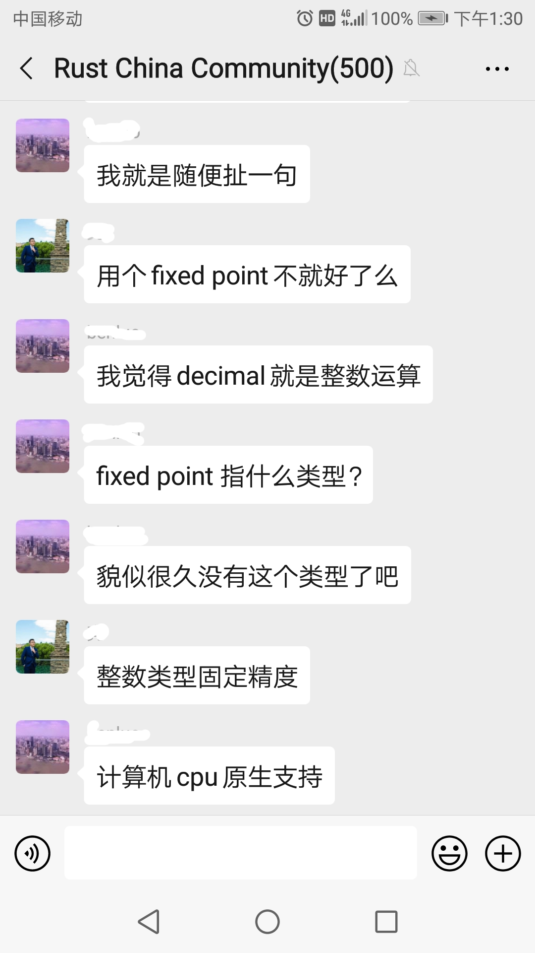
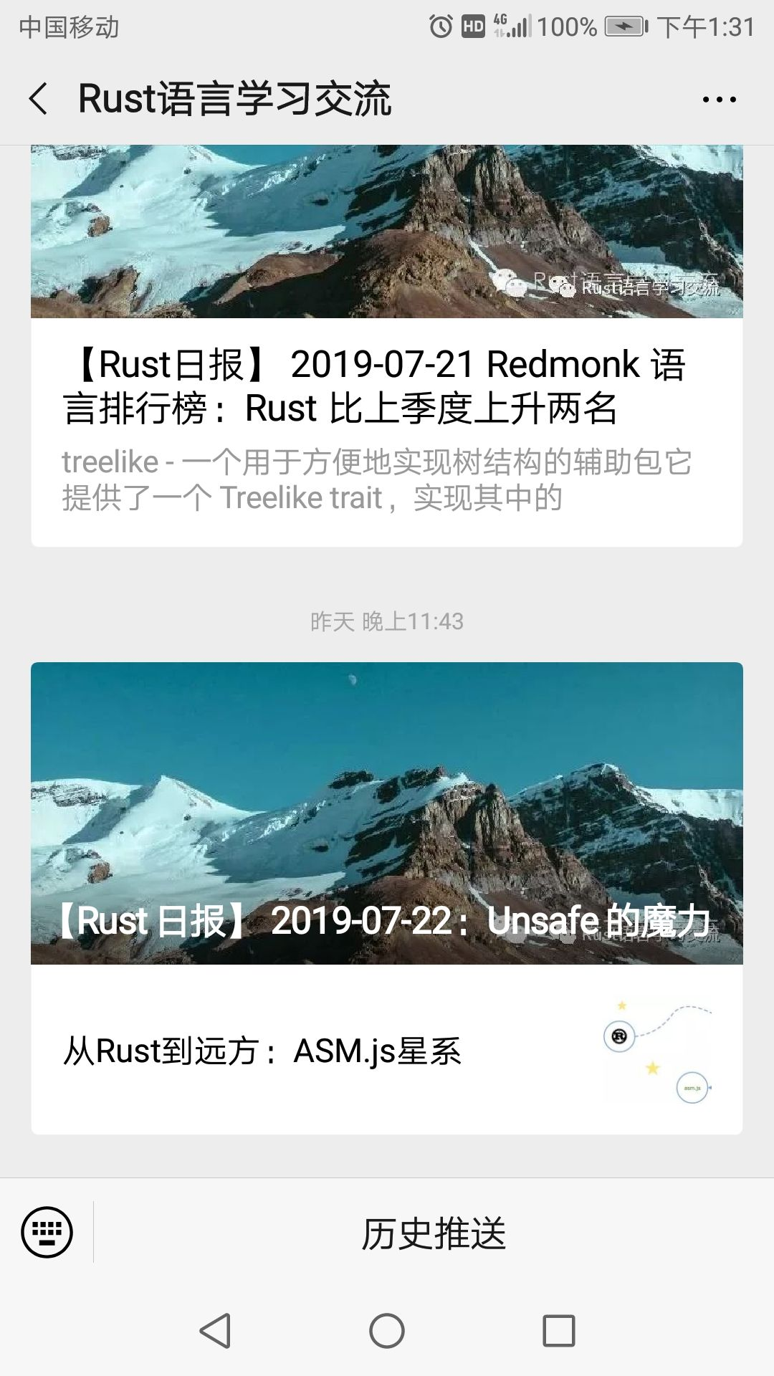
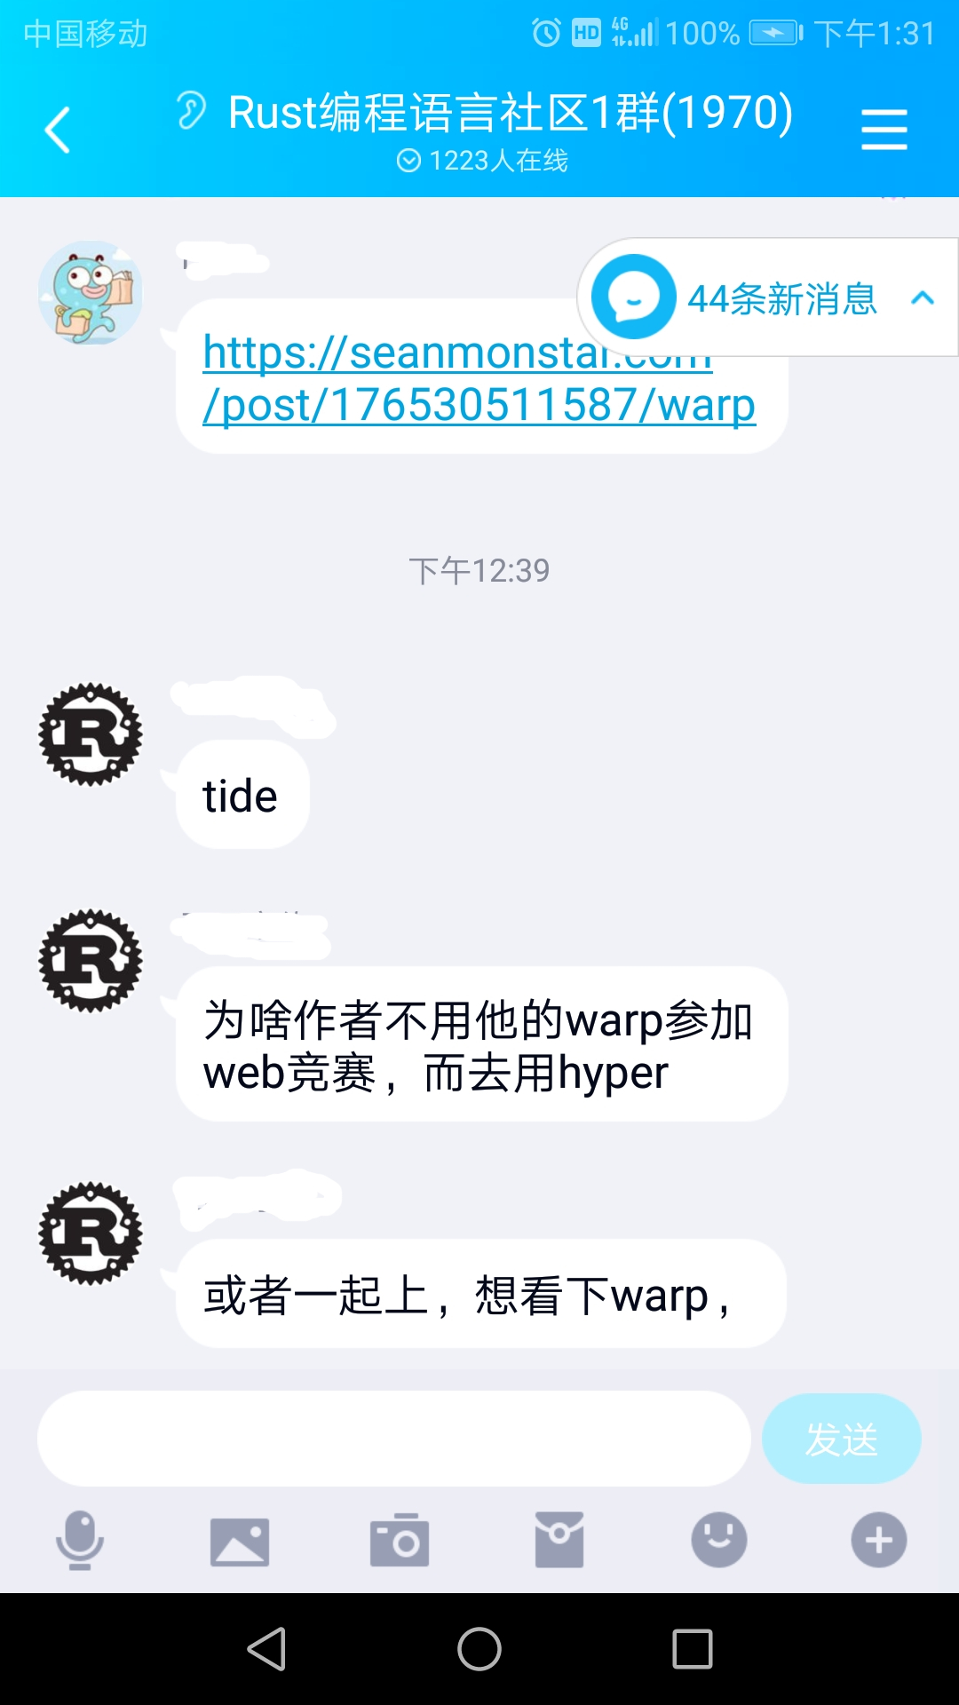
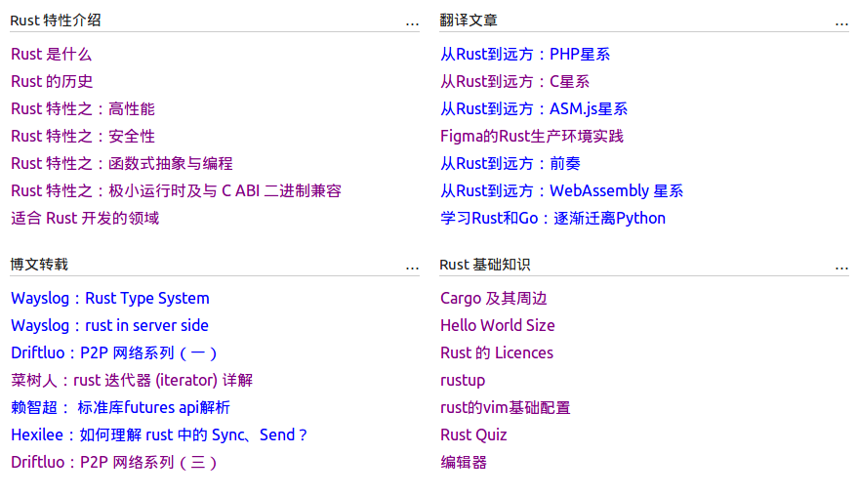
Rust Chinese Community (rust.cc)

Slide 12

Thank You
daogangtang@gmail.com
wx: daogangtang

